Slide 1
Benefits and Risks of
CLOUD
CLOUD COMPUTING

Slide 2
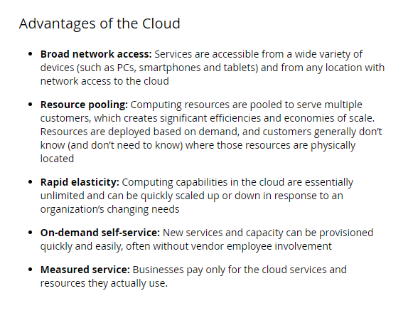
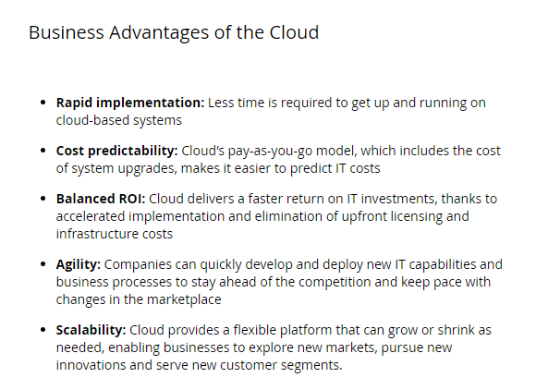
CLOUD BENEFITS

Slide 3
CLOUD RISKS
The risks IT system failings, power cuts, insider fraud, cyber attacks from criminal gangs and hostile states…
Moving services to the cloud transfers some of the risk management duties to the third party cloud service provider (CSP), but it is only the management of the risks that is transferred; accountability for the actual risks still resides with the company, not the CSP. Using the cloud also creates new types of risk. The company’s operational risk management framework must therefore take account of the special situations arising from cloud service adoption.
Cyber security The risk of intruders gaining access to IT systems on the internet, and even to closed systems, has forced organisations to improve security. Yet attacks keep coming and corporate defences are breached with depressing regularity. Cyber risk deserves special attention. Security must be tight.

Slide 4
Legal and regulatory compliance
Complying with national laws and regulations on data is a thorny problem that must be addressed. It raises difficult questions for businesses. Who owns the data? In which countries should the data be stored? Who is permitted access to data stored in another country? Data hosted on cloud services and other internet platforms is subject to the laws and regulations of the country where the data is stored.
It is therefore highly important to create a risk management and compliance framework for cloud. Otherwise there is a danger of getting bogged down in unfamiliar detail. A framework will help avoid pitfalls. It will help the company plot a route through all the risks and regulatory complexities, to ensure it gets the benefits it set out to get from the cloud.

Slide 5
